Slide 1
COMP6115 Object Oriented Analysis and Design Session #10

Slide 2
Human–Computer Interaction Layer Design

Slide 3
Learning Outcomes
LO1: Identify the basic concept of advance topic in
Object Oriented Analysis and Design
LO2 : Use the knowledge to develop documentation
for object oriented software analysis and
design using Unified Modelling Language
LO3 : Analyze any problem in any software
application and find out the alternative
solutions using object oriented analysis and
design approach

Slide 4
Chapter 10: Human–Computer Interaction Layer Design

Slide 5
Objectives
Understand several fundamental user interface (UI) design principles.
Understand the process of UI design.
Understand how to design the UI structure.
Understand how to design the UI standards.
Understand commonly used principles and techniques for navigation design.

Slide 6
Objectives (cont’d)
Understand commonly used principles and techniques for input design.
Understand commonly used principles and techniques for output design.
Be able to design a user interface.
Understand the effect of nonfunctional requirements on the human-computer interaction layer.

Slide 7
Introduction
Interface Design defines how the system will interact with external entities (e.g., customers, users, other systems)
System Interfaces are machine-machine and are dealt with as part of systems integration
User Interfaces are human-computer and are the focus of this chapter
Principles for UI design
The UI design process
Navigation, Input, Output Design
Mobile & social media UI design
Non-functional requirements and UI design

Slide 8
Principles of User Interface Design
Layout of the screen, form or report
Content Awareness—how well the user understands the information contained
Aesthetics—how well does it appeal to the user
User Experience—is it easy to use?
Consistency—refers to the similarity of presentation in different areas of the application
Minimal User Effort—can tasks be accomplished quickly?

Slide 9
Layout
The arrangement of items on the screen
Like items are grouped into areas
Areas can be further subdivided
Each area is self-contained
Areas should have a natural intuitive flow
Users from western nations tend to read from left to right and top to bottom
Users from other regions may have different flows

Slide 10
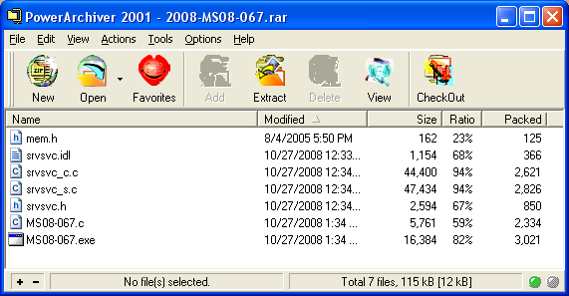
General Layout
Navigation Area
Reports & Forms Area
Status Area

Slide 11
Content Awareness
Applies to the interface in general, to each screen, to each area on a screen and to sub-areas as well
Include titles on all interfaces
Menus should show where the user is and how the user got there
All areas should be well defined, logically grouped together and easily discernible visually

Slide 12
Aesthetics
Interfaces should be functional, inviting to use, and pleasing to the eye
Simple minimalist designs are generally better
White space is important to provide separation
Acceptable information density is proportional to the user’s expertise
Novice users prefer lower density (< 50%)
Expert users prefer higher density (> 50%)
Text design: size, serif vs. sans serif, use of capitals
Color and patterns (e.g., don’t use red & blue)

Slide 13
User Experience
Ease of learning
Significant issue for inexperienced users
Relevant to systems with a large user population
Ease of use
Significant issue for expert users
Most important in specialized systems
Ease of learning and use of use are related
Complementary: lead to similar design decisions
Conflicting: designer must choose whether to satisfy novices or experts

Slide 14
Consistency
Extremely important concept in making the system simple
It allows the users to predict what is going to happen
All parts of the system work in the same way
Users learn how one portion works and immediately apply it to others
Key areas of consistency are
Navigation controls
Terminology—use the same descriptors on forms & reports

Slide 15

Minimal User Effort
Interfaces should be designed to minimize the effort needed to accomplish tasks
A common rule is the three-clicks rule
Users should be able to go from main menu of a system to the information they want in no more than three mouse clicks
1
2
3

Slide 16
User Interface Design Process
Use case driven, incremental and iterative process
Examine use case and sequence diagrams
Develop use scenarios hat describe commonly employed patterns of actions. It may uncover additional requirements
Once a basic set of use scenarios have been developed, the actual user interfaces are designed
Designed interfaces are evaluated to determine if they are satisfactory and how they can be improved
Interface design process is repeated in a cyclical process until no new improvements are identified.

Slide 17
Use Scenario Development
Use scenarios outline the steps performed by users to accomplish some part of their work
A use scenario is one path through an essential use case
Presented in a simple narrative description
Document the most common cases so interface designs will be easy to use for those situations

Slide 18
Navigation Structure Design
The navigation structure defines
The basic components of the interface
How they work together to provide functionality to users
Windows Navigation Diagrams (WND)
Similar to a behavioral state machine
Shows the relationship between all screens, forms, and reports used by the system
Shows how the user moves from one to another
Boxes represent components
Arrows represent transitions from and to a calling state

Slide 19
Windows Navigation Diagrams
Like a state diagram for the user interface
Boxes represent components
Window
Form
Report
Button
Arrows represent transitions
Single arrow indicates no return to the calling state
Double arrow represents a required return
Stereotypes show interface type

Slide 20
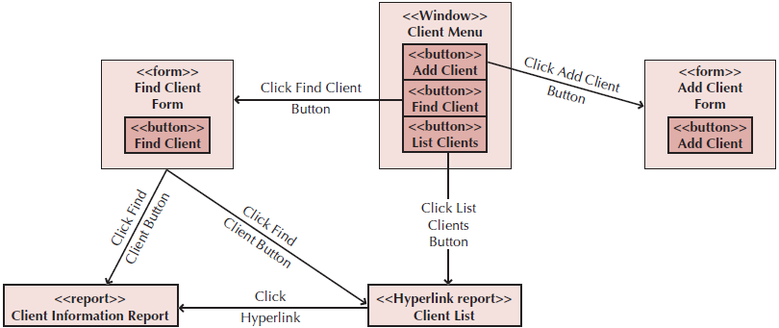
Sample Windows Navigation Diagram

Slide 21
Interface Standards Design
Interface standards are basic design elements found across the system user interface
Standards are needed for:
Interface metaphor: defines how an interface will work (e.g., the shopping cart to store items selected for purchase)
Interface objects
Interface actions
Interface icons
Interface templates

Slide 22
Interface Design Prototyping
Mock-ups or simulations of computer screens, forms, and reports
Four common approaches (listed in increasing detail)
Storyboard: hand drawn pictures of what the screens will look like
Windows layout diagram: a computer generated storyboard that more closely resembles the actual interface
HTML prototype: web pages linked with hypertext
Language prototype: more sophisticated than HTML
Built in the programming language with no real functionality
User does not have to guess about the final appearance of the screen

Slide 23
Interface Evaluation
Goal is to understand how to improve the interface design before the system is complete
Have as many people as possible evaluate the interface
Ideally, interface evaluation is done while the system is being designed—before it is built
Help identify and correct problems early
Designs will likely go through several changes after the users see it for the first time

Slide 24
Approaches to UI Evaluation
Heuristic—compare the design to known principles or rules of thumb
Walkthrough evaluation—design team presents prototype to the users & explains how it works
Interactive—the users work with the prototype with a project team member
Formal Usability Testing—performed in labs with users on a language prototype

Slide 25
Common Sense Approach to User Interface Design
Users should not have to think about how to navigate the user interface
The number of clicks should relate to the complexity of the task and should be unambiguous
Minimize the number of words on the screen

Slide 26
Navigation Design
The component that enables the user to navigate through the system
Also provides messages of success or failure of actions performed
Make it simple so that the user never really notices
Basic principles:
Prevent the user from making mistakes
Simplify recovery for the user when mistakes are made
Use a consistent grammar order
(e.g., File ► Open vs. Open ► File)

Slide 27
Types of Navigation Controls
Language
Command language—user types in a command to be executed
Natural language—system interprets the user’s language
Menus
User is presented a list of choices
Comes in different forms (e.g., menu bars, popups, drop downs)
Direct manipulation (e.g., drag and drop)
Voice recognition systems

Slide 28
Messages
How the system informs the user of the status of an interaction
Error messages—user did something that is not permitted
Confirmation messages (e.g., “Are you sure?”)
Acknowledgment messages (e.g., “Order entered”)
Delay messages—provides feedback to the user that the process is running
Help messages—provides additional information about the system to assist the user in performing a task

Slide 29
Navigation Design Documentation
Done using WNDs and real use-cases
Real use-cases are implementation dependent
Detailed description of how to use the implemented system
Essential use-cases evolve into real use cases by specifying them in terms of the actual user interface
For multi platform applications, e.g., desktops, tablets, and smartphones, real use cases will need to be developed for each platform on which the use case is being deployed.

Slide 30
Input Design
Screens that are used to input data
Data can be structured or unstructured
Structured: Dates, names, products, etc.
Unstructured: Comments, descriptions
Basic principles
Online vs. batch processing
Capture data at the source (e.g., barcode vs. RFID)
Minimize keystrokes (e.g., by using defaults for frequently used values)

Slide 31
Types of Inputs
Free form controls
Text boxes for alphanumeric information
Number boxes with automatic formatting
Example: Enter a phone number as 3451236789; automatically formats as (345)-123-6789
Password boxes that hide characters with stars and do not allow cutting or copying
Selection boxes
Check boxes when several items can be selected
Radio buttons when items are mutually exclusive
List boxes to present a set of choices
Sliders—a pointer that can be moved along a scale

Slide 32
Input Validation
Data should be validated prior to entry to ensure accuracy
Do not accept invalid data (e.g., input text when a number is required)
Validation checks:
Completeness
Format (e.g. MM/DD/YYYY)
Range (e.g. a number falls within a minimum and maximum value)
Check sum digit—reduces errors in entering numbers
Consistency—data are related
Database check—does not violate entity or referential integrity

Slide 33
Output Design
Reports produced from the data generated by the system
Basic principles:
Report usage and its frequency will affect its layout
Manage the information load in a report—provide only what is needed and place most important information near the top
Minimize bias, especially in graphical displays (charts)

Slide 34
Types of Outputs
Detail reports—users need full information
Summary reports—details are aggregated (e.g., sums, averages)
Exception reports
Turnaround documents—outputs turn around and become inputs
Graphs—for easy visual comparison
Media for reports can be electronic (seen on the screen) or hard copy (printed on paper)

Slide 35
Mobile Computing and UI Design
Smaller devices have limited space, touch screens and haptic feedback
Necessitate design from the ground up, not simply porting a web interface already designed for a larger computer
Capabilities of devices varies widely and are used everywhere under highly variable conditions (ambient light and noise levels)

Slide 36
Suggestions for Mobile Design
Focus on user needs, not user wants
Remove all “fluff” from big websites
Utilize the capabilities of the device (e.g., built-in GPS, accelerometers, etc.)
Make things vertically scrollable, not horizontally
Reduce interactions with the network to the extent possible
Make use of reusable patterns (e.g., vertically stacking web pages)
Designs for touchscreens (designer needs to consider tapping, pinching, spreading, flicking, scrolling (one-finger vs. two-finger), and dragging ,etc…)

Slide 37
Social Media and UI Design
Social media presents alternative opportunities and challenges
Facebook, Twitter, Flickr™, YouTube™
Wikis, blogs
Who is the target audience?
What is the purpose of the application? (e.g., marketing channel)
Which type of social media works best for your functional requirements?

Slide 38
Guidelines for Social Media
Post and update information often
Use a combination of push and pull approaches
Keep your sites synchronized to the extent possible
Allow customers to share your content
Provide a voting or “like” mechanism to encourage customers to become involved in your site
Design the site for longer term engagement
Build a sense of community—users “belong” to something
Take into account international and cultural issues

Slide 39
International & Cultural Issues in UI Design
Websites have a global presence
Considerations:
Multilingual requirements
The meaning of certain colors
Cultural differences
Power distance
Uncertainty avoidance
Individualism vs. collectivism

Slide 40
Non-Functional Requirements
Operational Requirements—choice of hardware and software platforms
Technologies that can be used (e.g. GUI, 2 or 3 button mouse)
Performance Requirements
Mobile computing and web browsing inject additional performance obstacles
Security Requirements
Appropriate log on controls and possibly encryption
Wireless networks are especially vulnerable
Political & Cultural Requirements
Date formats, colors, and currencies

Slide 41
Summary
Principles of User Interface Design
User Interface Design Process
Navigation Design
Input Design
Output Design
Mobile Computing and UI Design
Social Media and UI Design
International & Cultural Issues and UI Design
Nonfunctional Requirements

Slide 42
References
Denis, Wixom,Tegarden. (2015). Systems Analysis and Design: An Object-Oriented Approach with UML. 5th edition. ISBN: 978-1-118-80467-4, John Wiley & Sons, Inc, Denver (USA)

